Slide 1
DESN2000 MECH Workshop
Week 5 – Material Selection

Slide 2
Class overview
How this fits into your assignments
(5 min)
The process explained
( 5 min)
Example 1: Minimalist table
(25 min)
Example 2: Satellite telescope mirror
(25 min)
Project time!
(55 min)
Summary
(5 min)
Notes:
.

Slide 3
How this fits into your assignments
How this fits into your assignments | The process explained | Example 1: Minimalist table | Example 2: Satellite telescope mirror | Project time! | Summary
5 min | 5 min | 25 min | 25 min | 55 min | 5 min
All | All | All | All | All | All

Slide 4
How this fits into your assignments
Relevant for both teams that want to write a technical analysis and those who want to prototype!
Similar to fasteners, if your team wants to write a technical analysis:
This is one of 4 topics from which you must choose 2 to write about.
The tools covered in this workshop will enable you to explain in your report, why you decided on the materials you want your concept to be made from. Effective communication is an important industry skill!
If your team wants to prototype instead:
This may help you choose what material you might want to make your prototype from, to maximise the chance of it working.

Slide 5
The process explained
How this fits into your assignments | The process explained | Example 1: Minimalist table | Example 2: Satellite telescope mirror | Project time! | Summary
5 min | 5 min | 25 min | 25 min | 55 min | 5 min
All | All | All | All | All | All

Slide 6
The process explained
Will likely come from CNs and/or FRs
Determine from design constraints, FRs
Could be a length, radius, etc.
Book: Materials Selection In Mechanical Design, Michael F. Ashby
Create using equations describing the physical (e.g., mass) and mechanical (beam deflection) properties of interest.
1. Determine what design variables you want to optimise.
4. Create Material Index/s
5. Use an Ashby chart to select materials
2. Determine what design variables are constrained.
3. Determine what free variables remain
Notes:
Note to students: The textbook recommended in step 5 is available in library, we do have a pdf of just chapter 6, which contains a wide array of examples which students can use to help with their material selection.
This is the slide which hopefully all students can remember and take away from the class. It matters not if they get confused by the maths, if they understand this workflow, then the maths will only be a matter of time.

Slide 7
Example 1: Minimalist table
How this fits into your assignments | The process explained | Example 1: Minimalist table | Example 2: Satellite telescope mirror | Project time! | Summary
5 min | 5 min | 25 min | 25 min | 55 min | 5 min
All | All | All | All | All | All

Slide 8
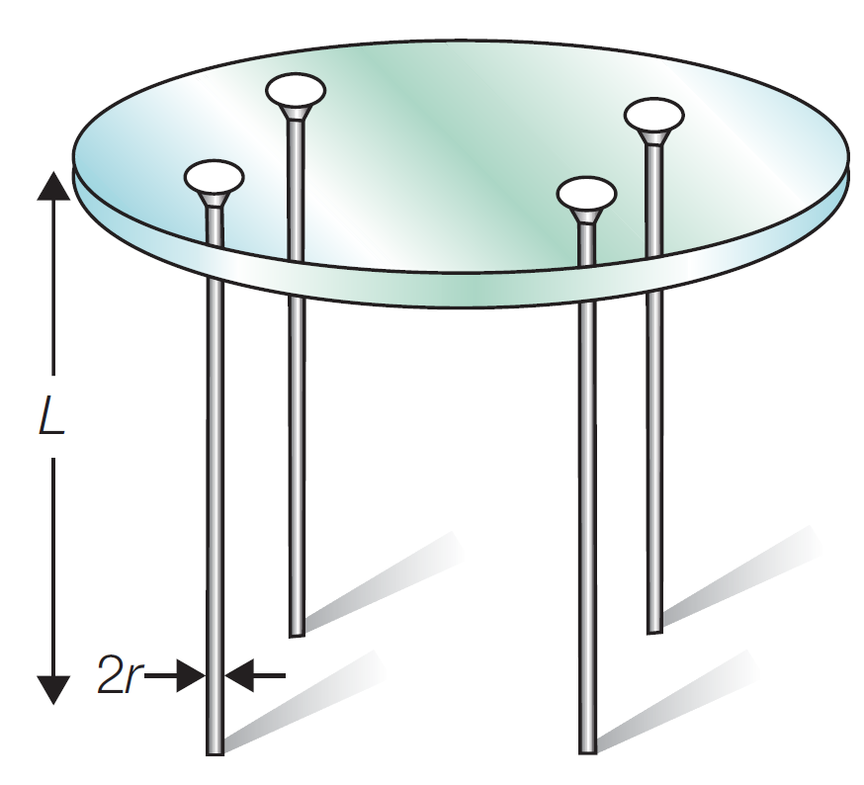

Example 1: Minimalist Table
Step 1: Decide what you want to optimise
We want to optimise the legs of the table.
Specifically, we want to: Minimise mass $\left(m\right)$, maximise slenderness $\left(r\right).$
Step 2: Determine constraints
Fixed leg length $(L)$, withstand buckling under design load $(F)$, resistant to fracture when struck.
Step 3: Identify free variables that remain
Diameter of table legs $(2r)$.
Step 4: Create material index/s
We will start with minimising the mass…

Slide 9

Example 1: Minimalist Table
Step 4a: Create material index for minimising mass
Good idea to begin with an equation which defines the variable that you are analysing. The table leg is a solid cylinder, whose mass can be defined as:
$$m = πr^{2}Lρ \left(1\right)$$
With leg radius $r,$ leg length $L$ and density $ρ.$
The key constraint that affects mass is the maximum load $F$ the leg can bear without buckling. The equation for elastic buckling of a column is given by
$$F_{crit}≥\frac{π^{2}EI}{L^{2}}=\frac{π^{3}Er^{4}}{4L^{2}} \left(2\right)$$
With Young’s modulus $E,$ second moment of area for column $I=\frac{πr^{4}}{4}.$
We now want to try to combine $F_{crit}$ and $m$ into a new equation that can describe their relationship

Slide 10


Example 1: Minimalist Table
Step 4a continued…
We can rearrange $\left(2\right)$ to make $r$ the subject in $F_{crit}≥\frac{π^{3}Er^{4}}{4L^{2}}$.
$$r^{4}≥F_{crit}\frac{4L^{2}}{π^{3}E}$$
$$r^{2}≥{\left(F_{crit}\frac{4L^{2}}{π^{3}E}\right)}^{\frac{1}{2}}\left(3\right)$$
Substituting $\left(3\right)$ into $\left(1\right)$ ($m = πr^{2}Lρ$),
$$m≥π×{\left(F_{crit}\frac{4L^{2}}{π^{3}E}\right)}^{\frac{1}{2}}×Lρ$$
Note that $F_{crit}, L$ and $π$ are all constants. Only $E$ and $ρ$ are material properties that we can choose. Let’s isolate them, to create an expression that relates mass to these properties.
$${m≥ \left(\frac{4Fcrit}{π}\right)}^{\frac{1}{2}}L^{2}\left(\frac{ρ}{E^{\frac{1}{2}}}\right) \left(4\right)$$
$$\frac{ρ}{E^{\frac{1}{2}}}$$
This is what we need to create our material index.

Slide 11

Example 1: Minimalist Table
Step 4a continued…
A common Ashby chart compares $E$ and $ρ$ in the form of $\frac{E^{\frac{1}{2}}}{ρ}.$ We have the inverse, $\frac{ρ}{E^{\frac{1}{2}}}$.
Thus, we can rewrite equation $\left(4\right)$ ${m≥ \left(\frac{4Fcrit}{π}\right)}^{\frac{1}{2}}L^{2}\left(\frac{ρ}{E^{\frac{1}{2}}}\right)$ as,
$${m≥ \left(\frac{4Fcrit}{π}\right)}^{\frac{1}{2}}L^{2}\frac{1}{\frac{E^{\frac{1}{2}}}{ρ}}$$
This is our material index $M1=\frac{E^{\frac{1}{2}}}{ρ}$. By maximising it we will find materials that can minimise the weight.
Ok, now let’s optimise for slenderness

Slide 12

Example 1: Minimalist Table
Step 5b: Create material index for maximising slenderness
Let’s go back to equation 2,
$$F_{crit}≥\frac{π^{3}Er^{4}}{4L^{2}} \left(2\right)$$
If we make $F_{crit}=F$ (the applied load) we can reverse the inequality (the applied load must always be less than or equal to the critical load). Then, we can rearrange to make $r$ the subject. Thus,
$${{\left[\frac{1}{E}\right]}^{\frac{1}{4}}\left(\frac{4F}{π^{3}}\right)}^{\frac{1}{4}}L^{2}≤r$$
This is our second Material Index, $M2=E.$ We see that if $E$ increases, $r$ will decrease. Let’s put this and $M1$ to use on our Ashby chart.

Slide 13
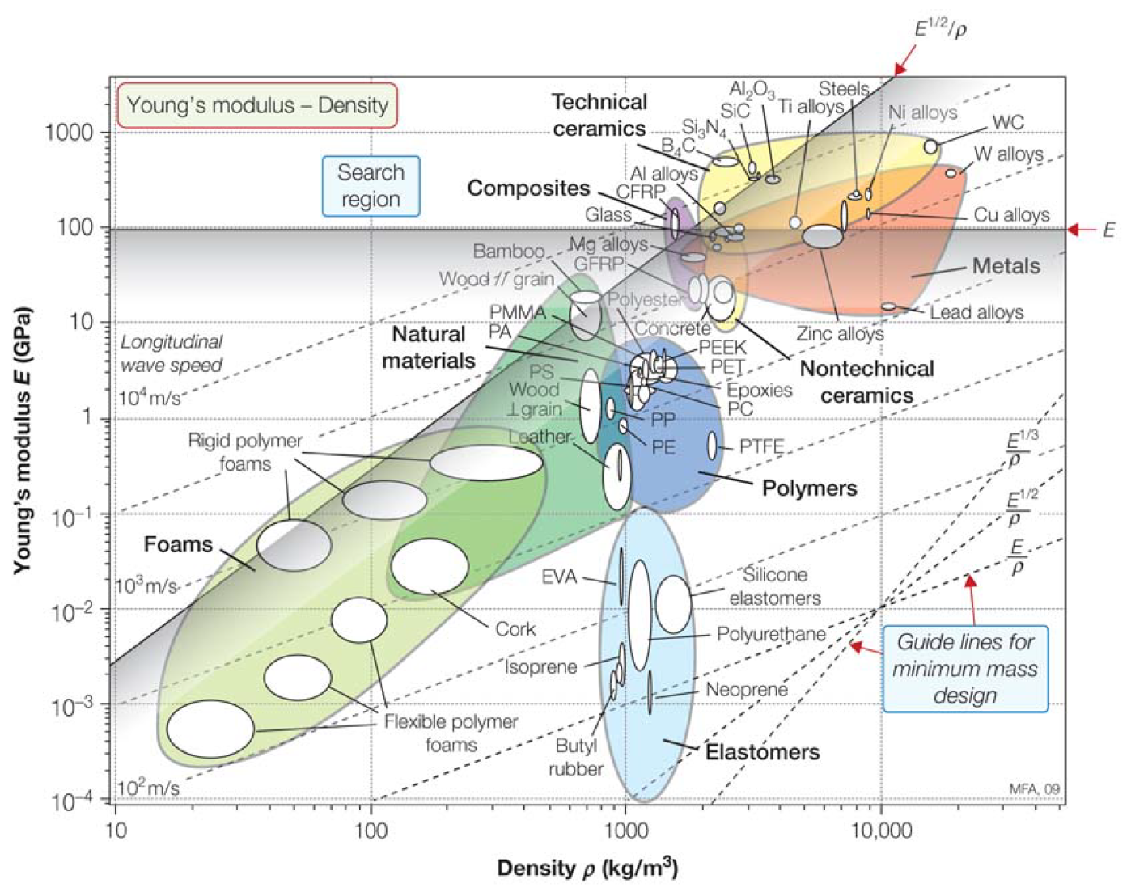
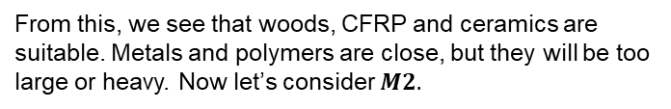

Example 1: Minimalist Table
Step 5: Use Ashby chart to select materials
Our material index comprises of $E$ and $ρ$. Thus, we need an Ashby chart which compares these values.
Let’s start with$M1=\frac{E^{\frac{1}{2}}}{ρ}$. Find the tie-line (dotted line) which matches our material index.
Move the line up until a reasonably small subset of materials is above the line (we want to maximise $M1$ remember).
Any material along the line will at a minimum fulfil the criteria of withstanding $F_{crit}.$ Materials above the line will perform better than minimum, materials below the line will fail to meet the requirements.
From this, we see that woods, CFRP and ceramics are suitable. Metals and polymers are close, but they will be too large or heavy. Now let’s consider $M2.$
Notes:
CFRP is Carbon Fiber Reinforced Plastic
From what I’ve read so far, I don’t have a full understanding of why the gradients of the tie-lines correspond to what is shown. Based on the text, the tie-line used on this slide has a gradient of 2. If you have a better understanding of how to obtain the gradient (because I don’t think all Ashby charts have these pre-defined tie lines), please explain it to your students.
However, if you are also unsure, it is not a big issue. For the most part, if students are using Ashby charts from the textbook, most of them have these pre-labelled. In that case, most of the time students can just match the tie-line to what is shown on the chart and move them as needed.
If students are unsure about how far to move the line, how much the line is moved is subjective. The goal is to capture a reasonably small subset of materials so that the obviously unsuitable ones are ruled out. Considerations of constraints identified in step 2 will also help this.

Slide 14

Example 1: Minimalist Table
Step 5: Use Ashby chart to select materials
Plotting $E$ on the Ashby chart is in this case, just a horizontal line since the $y−axis$ is Young’s modulus.
As with minimising mass, we move the line up until a reasonably small subset of materials is above the line.
We see that applying $M2$ eliminates wood (not strong enough if made very thin), leaving only CFRP and ceramics. Considering the constraint that the legs must not crack when struck, ceramics are eliminated, because they are too brittle.
Thus, based on our analysis, CFRP is the best material (though expensive!!!)

Slide 15
Example 2: Satellite telescope mirror
How this fits into your assignments | The process explained | Example 1: Minimalist table | Example 2: Satellite telescope mirror | Project time! | Summary
5 min | 5 min | 25 min | 25 min | 55 min | 5 min
All | All | All | All | All | All

Slide 16
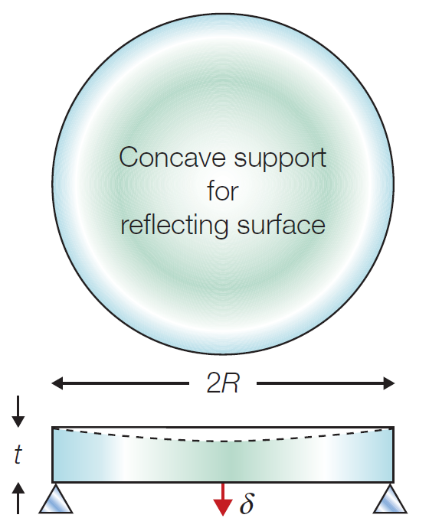
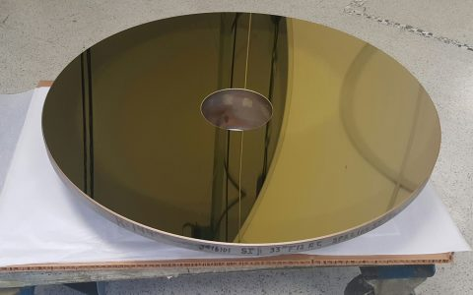

Example 2: Satellite Telescope Mirror
Step 1: Decide what you want to optimise
We want to optimise the mirror itself.
Specifically, we want to minimise mass $\left(m\right).$
Step 2: Determine constraints
Fixed mirror radius $(R)$, mustn't distort more than $δ$ under self-weight. High dimensional stability (retains shape well), low thermal expansion.
Step 3: Identify free variables that remain
Thickness $\left(t\right).$
Step 4: Create material index/s
Notes:
I recommend that students have a try at solving this one themselves in their groups first before the solution is given. Leave the presentation on this slide to help students follow the initial setting-up process prior to attempting to create the material index. How much time you wish for them to have a go is up to you. Ask students if they need help and go through the solution once you see most people have arrived/almost arrived at solutions or if everyone is struggling.

Slide 17

Example 2: Satellite Telescope Mirror
Step 4: Create material index/s
Let’s begin with defining an equation for the mirror’s mass
$$m=πR^{2}tρ (1)$$
Where $R=$ radius, $t=$ thickness, $ρ=$ density. (the concavity of the mirror is ignored for simplicity).
The mirror will be supported horizontally around its circumference, which means it will bend at the centre under its own weight. For a material with Poisson’s ratio of 0.3, this mode of deflection – a horizontal disk at the centre, is given by,
$$δ=\frac{3}{4π}\frac{mgR^{2}}{Et^{3}} (2)$$
We can substitute $\left(2\right)$ into $\left(1\right)$ to ensure that our mass equation accounts for this constraint, $δ.$

Slide 18
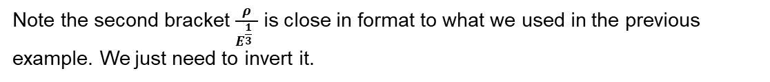

Example 2: Satellite Telescope Mirror
Step 4: Create material index/s
Before we substitute, we’ll rearrange $\left(2\right)$ making $t$ the subject,
$$t={\left(\frac{3}{4π}\right)}^{\frac{1}{3}}{\left(\frac{mgR^{2}}{Eδ}\right)}^{\frac{1}{3}}\left(3\right)$$
Substituting $\left(3\right)$ into $\left(1\right).$
$$m=πR^{2}t{\left(\frac{3}{4π}\right)}^{\frac{1}{3}}{\left(\frac{mgR^{2}}{Eδ}\right)}^{\frac{1}{3}}ρ$$
If we redistribute the variables, we will find that,
$$m={\left(\frac{3g}{4δ}\right)}^{\frac{1}{2}}πR^{4}{\left[\frac{ρ}{E^{\frac{1}{3}}}\right]}^{\frac{3}{2}}$$
Note the second bracket $\frac{ρ}{E^{\frac{1}{3} }}$ is close in format to what we used in the previous example. We just need to invert it.

Slide 19
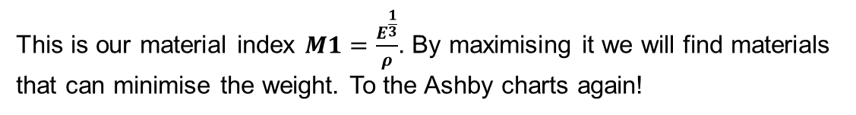
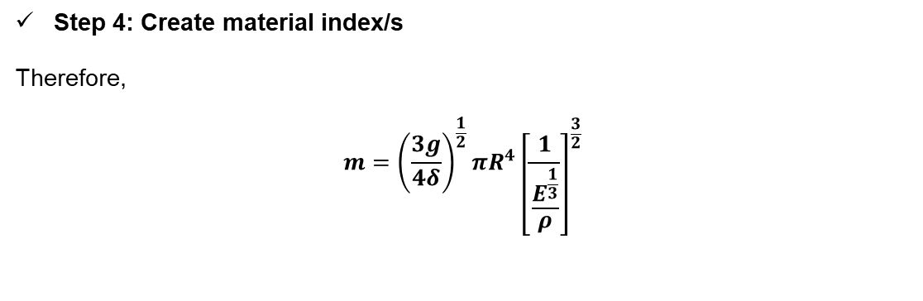
Example 2: Satellite Telescope Mirror
Step 4: Create material index/s
Therefore,
$$m={\left(\frac{3g}{4δ}\right)}^{\frac{1}{2}}πR^{4}{\left[\frac{1}{\frac{E^{\frac{1}{3}}}{ρ}}\right]}^{\frac{3}{2}}$$
This is our material index $M1=\frac{E^{\frac{1}{3}}}{ρ}$. By maximising it we will find materials that can minimise the weight. To the Ashby charts again!

Slide 20
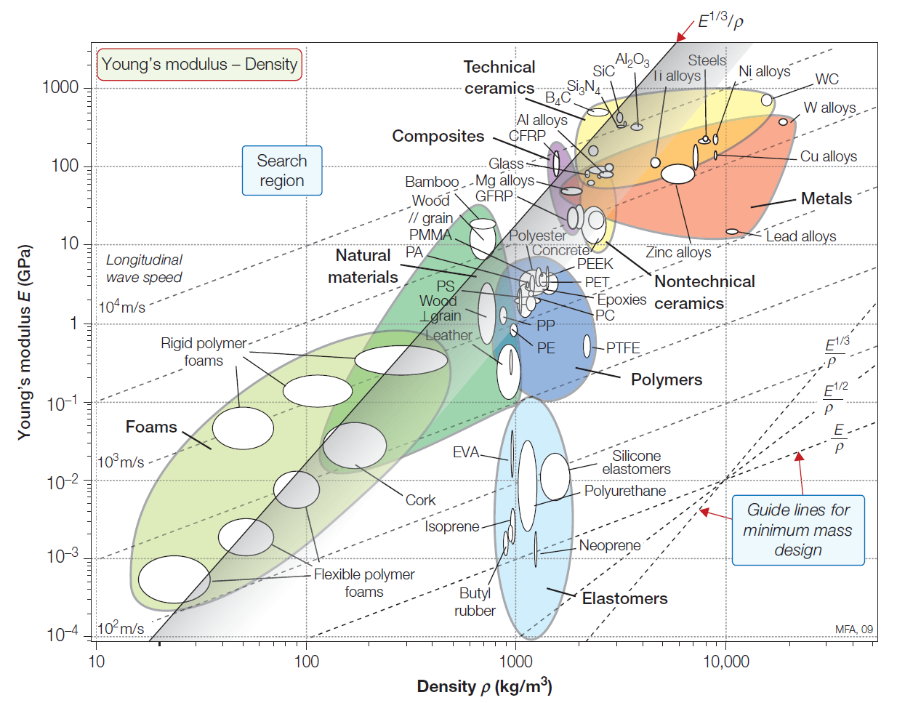

Example 2: Satellite Telescope Mirror
Step 5: Use Ashby chart to select materials
We use the tie-line for $\frac{E^{\frac{1}{3}}}{ρ}$ this time.
Moving the line up until a reasonably small subset of materials is above the line, we see that rigid foam polymers, glass, CFRP and a few ceramics lie on or slightly above the line. Magnesium and aluminium alloys are also close contenders.
To narrow down our choice, we should consider some of the constraints.

Slide 21
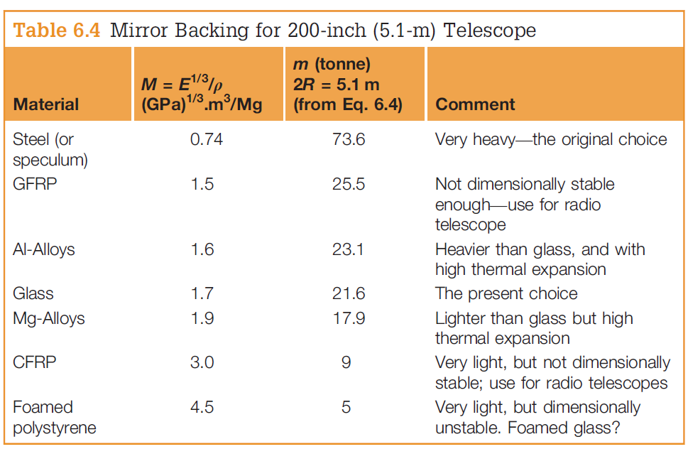
Example 2: Satellite Telescope Mirror
Foam technically could be used and would be very light, but unlikely to retain shape well.
Composites are also close in weight but are still impacted by dimensional instability.
Metals are heavy and also vulnerable to heat expansion.
Considering the choices, likely CFRP will be the best choice for a single material mirror. However, here is potential space for innovation.
Perhaps additional structural reinforcement in the mounting hardware could be used to account for the instability of CFRP.
The key message is, there is no perfect material. You will always have to account for some compromise.
Notes:
The key message is that this process is not exact. There won’t be a perfect material. Sometimes the limitations are acceptable. For example, radio telescopes which don’t need high optical clarity, often make their reflectors out of CFRP as it is much lighter.

Slide 22
Material Selection Process: Key Takeaways
This is not an exact process. Physical testing would still be needed in the detail design phase to verify your choices (out of course scope).
Formulating the material index is tricky. If unsure, go back and consider what is your key constraint. Is it that the part must support a certain load? Resist bending in a particular manner?
Often these are connected to equations involving material properties, which you can substitute into your equation which describes the variable you are trying to optimise for. This then creates a new expression which relates material properties to the variable you are designing for.
If you’d like to see more case studies, Chapter 6 of the textbook (Materials Selection In Mechanical Design) contains the examples shown today and many more. You may be able to adapt some of them to your analysis (Don’t forget to reference if you do use it ☺)
Notes:
Feel free to add on your own material selection advice here.

Slide 23
Project time !
How this fits into your assignments | The process explained | Example 1: Minimalist table | Example 2: Satellite telescope mirror | Project time! | Summary
5 min | 5 min | 25 min | 25 min | 55 min | 5 min
All | All | All | All | All | All
Notes:
As per normal, any remaining time can be used for groupwork time.

Slide 24
Summary
How this fits into your assignments | The process explained | Example 1: Minimalist table | Example 2: Satellite telescope mirror | Project time! | Summary
5 min | 5 min | 25 min | 25 min | 55 min | 5 min
All | All | All | All | All | All

Slide 25
Summary
Today we covered:
Material selection
Reminder:
Design journal due Monday Week 7 at 0900.
Next week:
Sensor selection

